Slide 1
MILESTONE 4- Presenting Your Findings
Sports Stats

Slide 2
CONTENTS
Review of Questions to Answer/ Hypotheses/Approach
3-5
Discuss Technical Challenges
6
Detail: ERD
7
Initial Findings
8-9
Deeper Analysis
10-11
Hypotheses Result
12
Recommendations and Actions
13
End 14

Slide 3




1. How do demographic factors like (i.e., height, weight, gender and country (NATO and non-NATO)) influence an Olympian winning Gold?
The wealthier the countries the taller and more built you will be - due to nutrition and funding.
2. Which sports have been the most consistently winning amongst *NATO countries; do they have a competitive advantage?
Reasoning similar to above
Audience
The audience is the external audience - sports historians and journalists - people who are interested in the world and field of sports, more specifically, Olympics. They will use these findings to their own studies in the near future.
SECTION 1: Questions to Answer

Slide 4
I hypothesize that there is a statistically significant relationship between an Olympian's height, weight, gender and NATO countries and them winning Gold medals at the Olympics.
As the wealthier the countries are the better the funding/nutritions are for the Olympians
I hypothesize that NATO countries consistently achieve higher Gold medal counts due to competitive advantages, in comparison with non-NATO countries
Reasoning similar to above
SECTION 2: Initial Hypotheses

Slide 5
I’ll be looking at primarily at a linear regression model (predictors)
Gold medals
Demographics (height, weight, gender and countries (NATO and non-NATO)
Will also use a line and residual plot graph
To check for any correlations/patterns
SECTION 3: Data Analysis Approach

Slide 6
Some of the technical challenges I faced over the course of this project were:
Encountered challenges regarding cleaning the dataset early on, which required me to go back, check for nulls and duplicates, on DataBricks as that was something I wasn’t used to using. However, once I got the hang of it, it became easier to to the SQL queries on it.
Limitations of the things I could write on SQL queries: there were some things I wanted to write but couldn’t due to errors. That took a long time to fix and get the data I was trying to measure.
TECHNICAL CHALLENGES

Slide 7
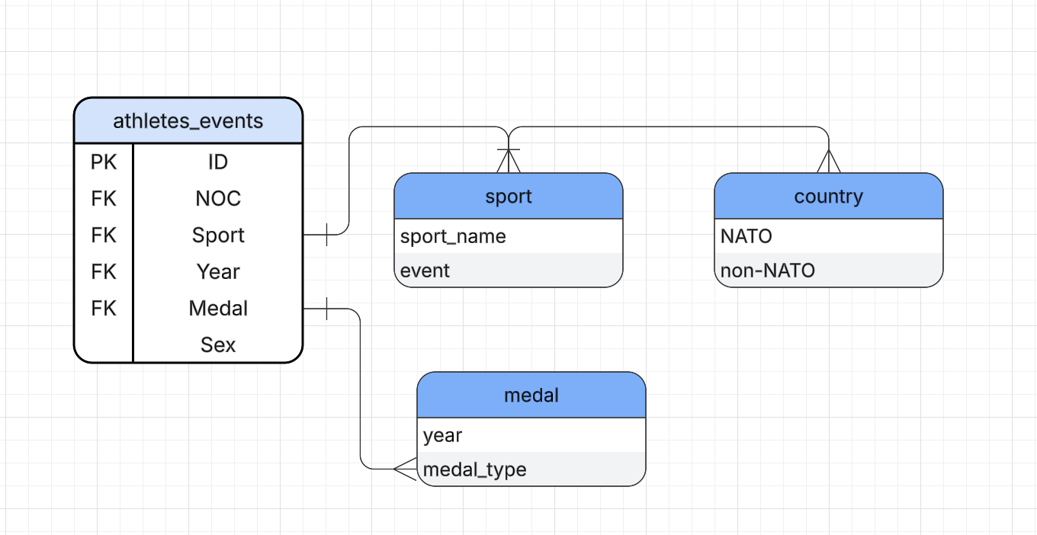
ERD: Entity Relationship Diagram

Slide 8
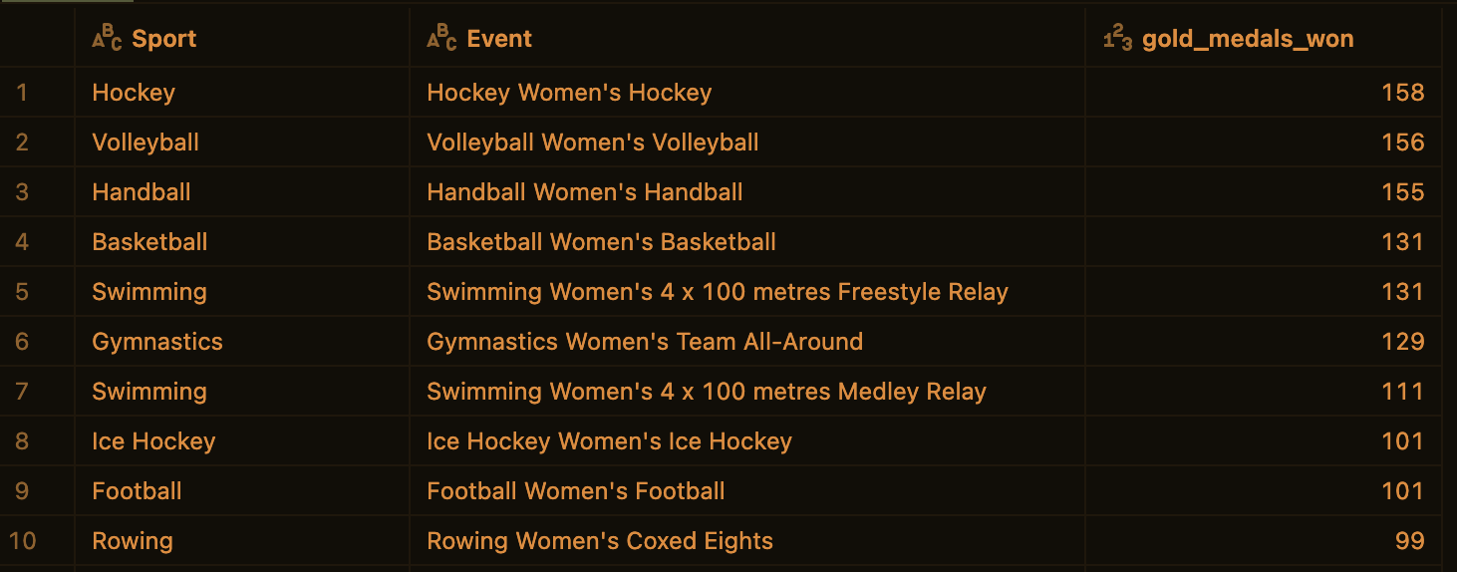
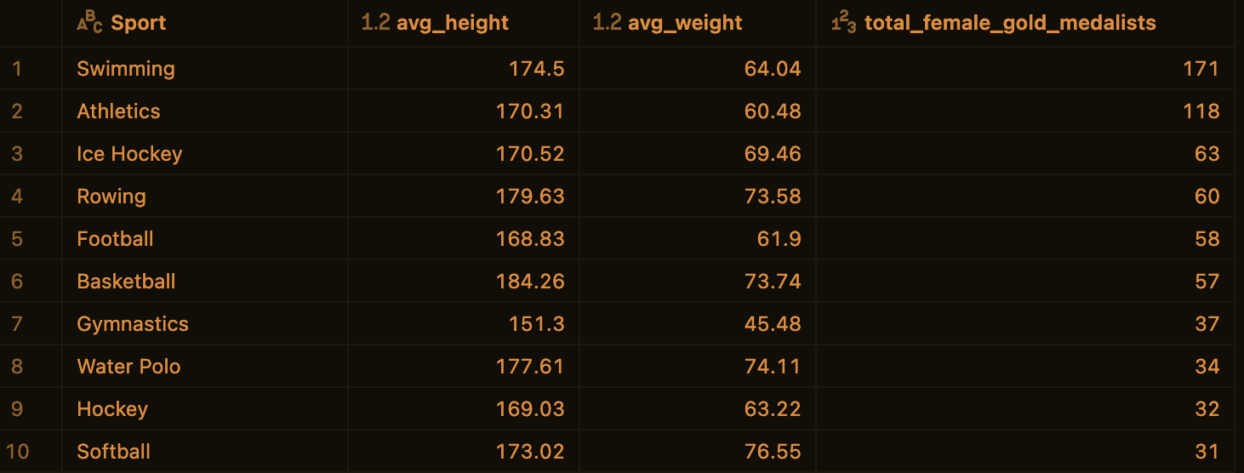
Initial Findings
– Found that initial hypotheses were evident in the data, however, there is more to be discovered and deeper analysis needs to be investigated.

Slide 9
Initial Findings cont’d
Women Olympian winning (Gold) Sport/Events:
*What sports do women olympians win the most Gold in.
Women Olympian (Gold) Medalists in NATO Countries:
* The women olympians who won Gold how many of them were from NATO countries.
Women Olympian (Gold) Medalist Demographics in NATO countries:
* What is the demographics (avg. height and weight) of those gold medalists in those sports (the most dominant) who were in those NATO countries.
Description:
My goal is to identify and analyze any correlation/patterns in the Olympian’s gender and the demographics (height, weight, country) at play. Do these demographics help or hinder their ability to win Gold? Hopefully, The primary audience will be sports historians and journalists who might be interested in knowing the evolving statistics between old and new emerging countries winning gold. One thing I should have added were the year metrics.

Slide 10
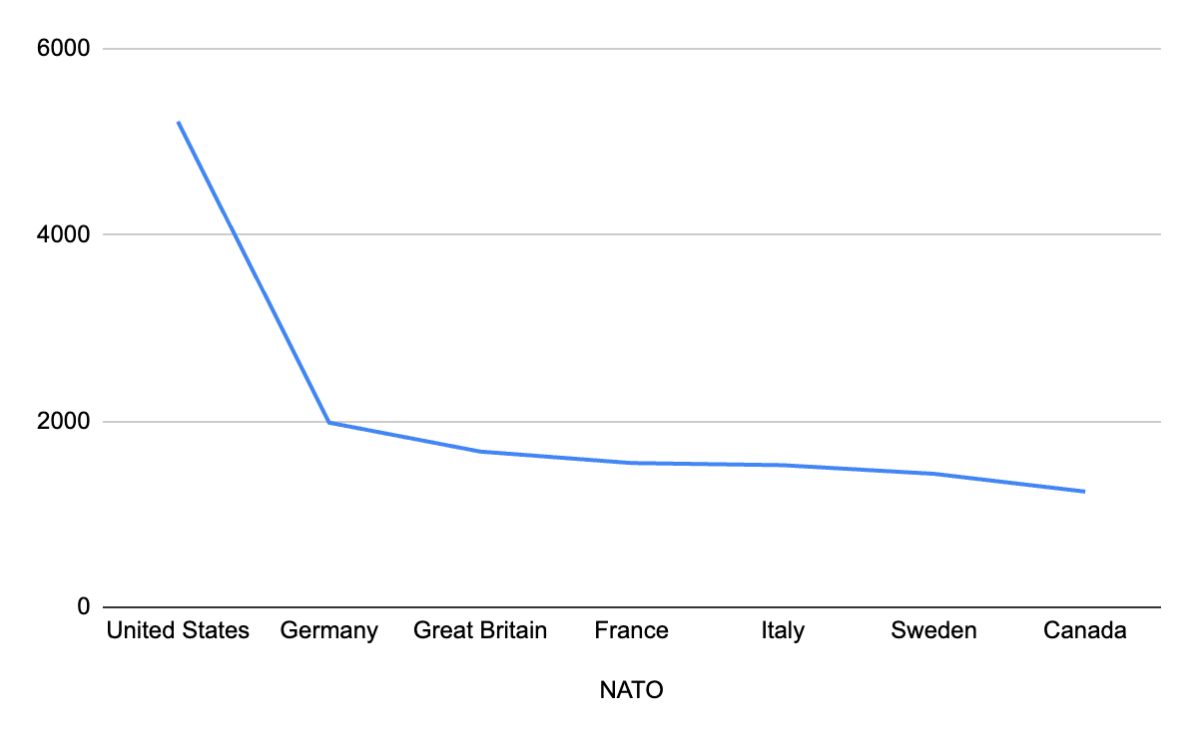
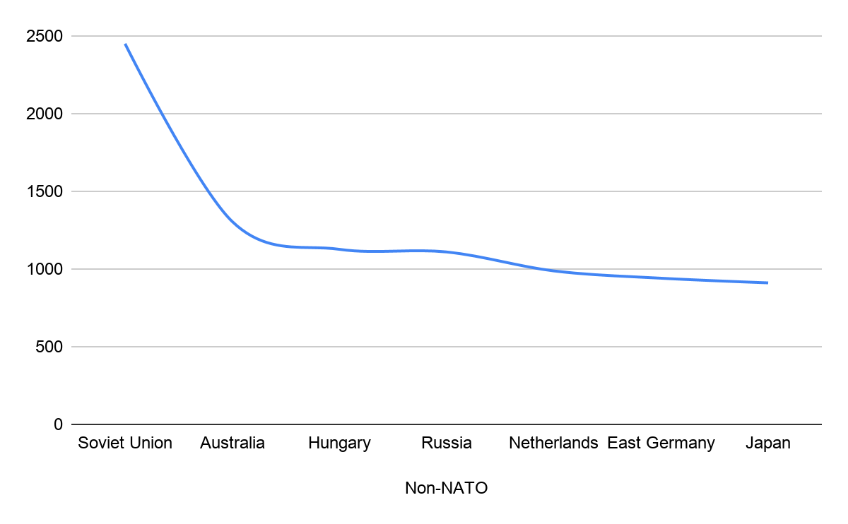
Deeper Analysis (Medal)
Deeper Analysis (Medal-Non-NATO)
Explanation: Medals/Metrics
DEEPER ANALYSIS
The medal analysis by NATO countries has shown that NATO countries have always shown a higher count in Gold medals in comparison to non-NATO countries.
With the United States taking the lead with 5219 gold medals and the Soviet Union taking the lead with 2451 gold medals. The ratio becomes 1.66. Although, NATO countries have an advantage, with winning 1.66 more times, than non-NATO countries. They are slowly taking the lead.
New Metrics: Year
This metric will hopefully correctly identify the total medals each region has won since 1945 (end of WW2). This will tell if the year itself has made any improvements in the regions outperforming in different years relative to the overall medals each region has won.

Slide 11
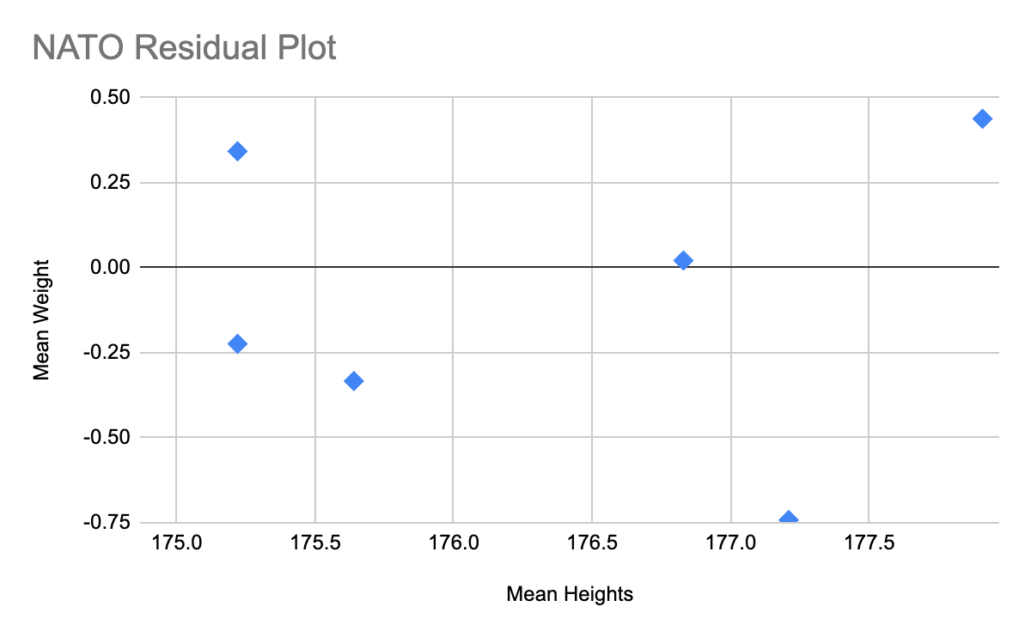
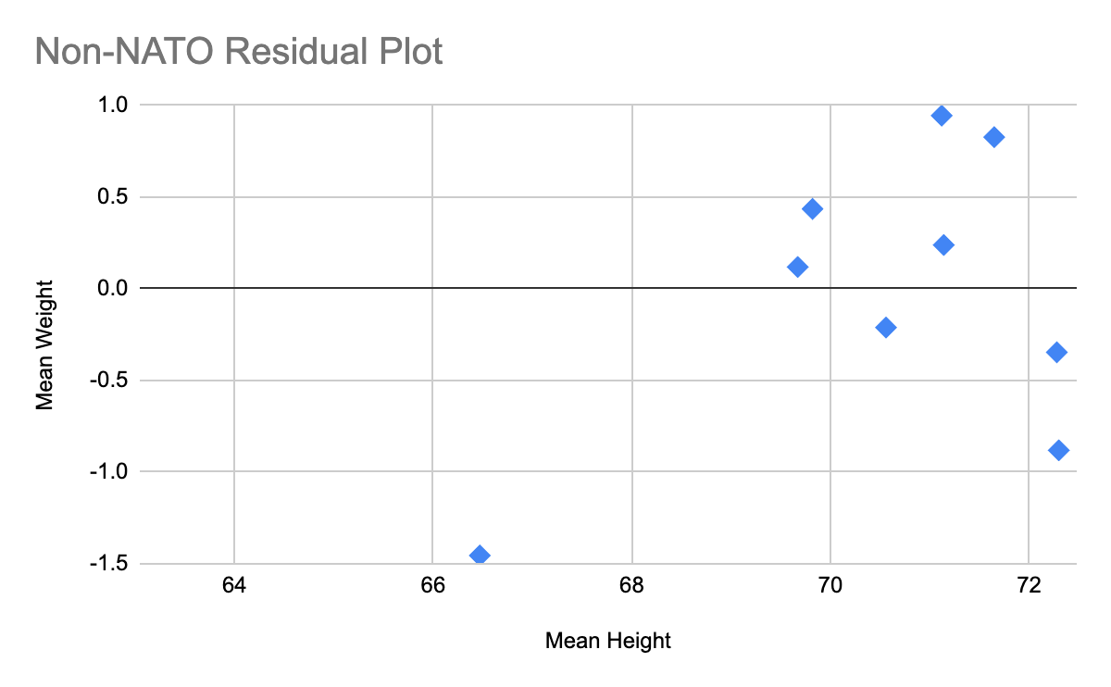
NATO Countries Linear Regression Model
Non-NATO Countries Linear Regression Model
Explanation: Linear Regression Model
DEEPER ANALYSIS cont’d
These observations regarding that height and weight amongst NATO countries is high, the males olympians generally outnumber the female olympians, the age amongst the NATO and non-NATO countries have been very similar.

Slide 12
Hypothesis #1 shows that it is partially supported, but there are more variables in count. There is still a relationship- but not as strong as I had expected it to be.
These observations regarding that height and weight amongst NATO countries is high, the males olympians generally outnumber the female olympians, the age amongst the NATO and non-NATO countries have been very similar.
However, comparing a NATO average Olympian to a non-NATO olympian winning more Gold medals is not very plausible as Olympic success varies by sport for example, Gymnastics favors more petite athletes while track and field favors athletes who are much lighter and taller.
Hypothesis #2 shows that we can see from the data that this is supported.
The initial hypothesis was that NATO countries consistently achieve higher Gold medal counts due to competitive advantages, in comparison with non-NATO countries.
The medal analysis by NATO countries has shown that NATO countries have always shown a higher count in Gold medals in comparison to non-NATO countries.
Final Findings (Result of Hypotheses)

Slide 13
In conclusion, while doing this project and finding the data, I came with some recommendations on what would be best for the client to do. They should take account for the metrics such as Year, in part of using that for measuring the demographics (Height, Weight, Gender and countries (NATO and non-NATO). When I was measuring, the first time I didn’t take the year in account, believing that it might not have a bigger effect as compare to the other demographics, but, I was wrong.
Some of the relationships I have found or any ‘Aha’ moments were through the statistics, I have seen, gender plays a big role in overall medals but specifically in gold medals, it is not as cut and dry, as you may think, the statistics have shown that many women have won gold medals in predominantly male sports.
Recommendations and Actions

Slide 14
Thank you!
Sports Stats

